Slide 1
Digital Portfolio
STUDENT NAME: Saravanan A
REGISTER NO AND NMID: astvu20420424u18102
DEPARTMENT: BSC-Computer Science
COLLEGE: Kalaignar karunanithi Government Arts College,
Tiruvannamalai/Thiruvalluvar University.

Slide 2
PROJECT TITLE
STUDENT PORTFOLIO
USING FRONTEND DEVELOPMENT

Slide 3


AGENDA
Problem Statement
Project Overview
End Users
Tools and Technologies
Portfolio design and Layout
Features and Functionality
Results and Screenshots
Conclusion
Github Link
3/21/2024 Annual Review

Slide 4

PROBLEM STATEMENT
In today's digital era, traditional resumes alone are not enough to showcase skills and projects effectively. Many students and professionals lack a structured online presence to highlight their work. A digital portfolio provides an interactive and accessible platform to present achievements, skills, and experiences.

Slide 5

PROJECT OVERVIEW
File summary: The file is a simple README referencing a CodePen project titled Student Portfolio. It links to your work hosted on CodePen.
Portfolio contents: It appears to be a personal portfolio page intended to showcase information about you, your skills, projects, and possibly contact details.
Main idea: The portfolio aims to present your profile as a student or developer in a structured way so viewers (like potential employers, teachers, or collaborators) can quickly understand who you are and what you can do.

Slide 6

WHO ARE THE END USERS?
1.Students (academic projects, resumes).
2.Job seekers (to share with recruiters).
3.Freelancers (to show clients).
4.Professionals (to highlight experience and achievements).

Slide 7

TOOLS AND TECHNIQUES
HTML-The portfolio uses standard HTML5 elements to structure content, including headings, sections, and navigation links. Semantic tags organize information clearly, while embedded resources (like images and links) present projects and skills in an accessible way.
CSS -The portfolio uses modern CSS features like Flexbox and Grid for layout, smooth scrolling, and hover transitions for interactive elements. It applies linear gradients, responsive media queries, and consistent styling to create a clean, mobile-friendly design.
JavaScript -The portfolio uses JavaScript to add interactivity, such as dynamic content updates and smooth scrolling. Basic DOM manipulation techniques enhance user experience by making the page more responsive and engaging.
My code editor CODEPEN and hosting platform (GitHub Pages)

Slide 8
POTFOLIO DESIGN AND LAYOUT
Home:1.The Home section welcomes visitors with a clear introduction and quick navigation to key parts of the portfolio.
2. It highlights your name, role, or field of study to immediately establish identity.
3.The About Me section gives a short background about your education, interests, and career goals.
4. It emphasizes your passion for learning and showcases personal strengths or qualities.
5. Together, these sections create a strong first impression and invite viewers to explore your work further.
Projects:The portfolio highlights student work with clear titles and descriptions, showcasing practical skills. Each project section is structured to demonstrate creativity, technical ability, and real-world application.
Skills:The portfolio highlights core web development abilities, including HTML for structure, CSS for styling, and JavaScript for interactivity. These skills demonstrate the ability to build and customize functional, user-friendly websites.
Contact Section:The portfolio includes a dedicated contact area that provides visitors with ways to reach out, typically through email links or contact forms. It ensures easy communication between the student and potential employers or collaborators.
Responsive Layout:The portfolio uses flexible layouts and media queries to adjust content for different screen sizes, ensuring it looks good on both mobile and desktop devices. This approach improves accessibility and user experience across platforms.
8

Slide 9
FEATURES AND FUNCTIONALITY
1. The portfolio displays personal details, skills, and project highlights in a structured format.
2. Navigation links allow users to move smoothly between sections of the page.
3. Responsive design ensures it adapts to both mobile and desktop screens.
4. Interactive elements powered by JavaScript improve user engagement.
5. The layout uses clear visual sections to emphasize achievements and contact information.

Slide 10

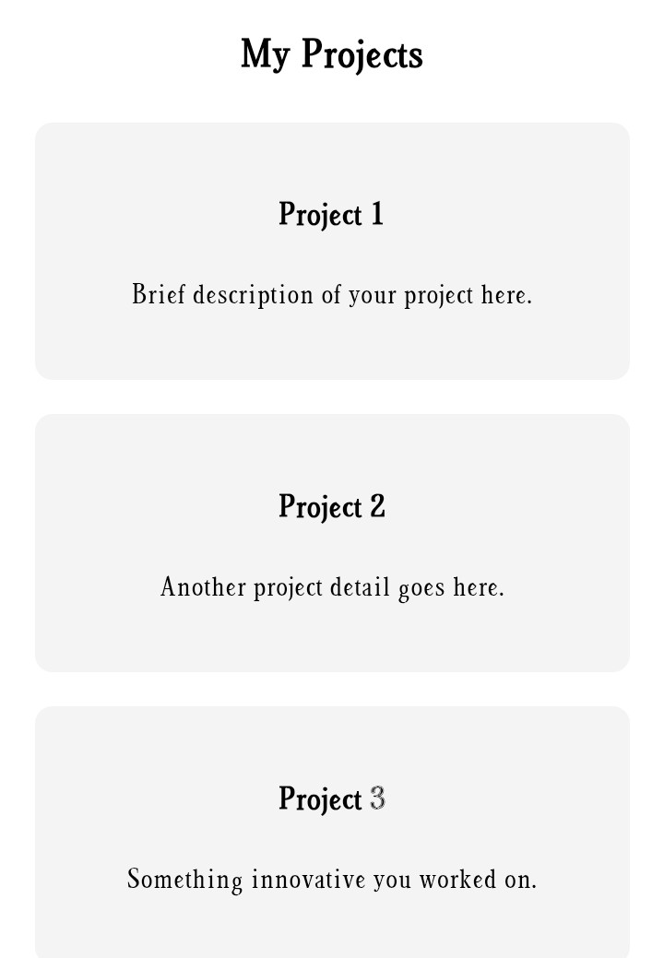
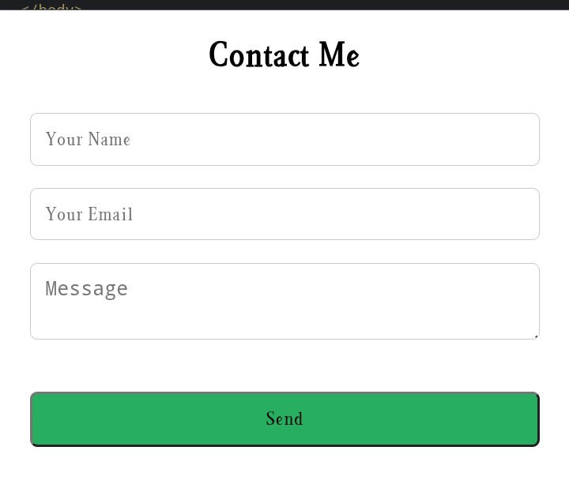
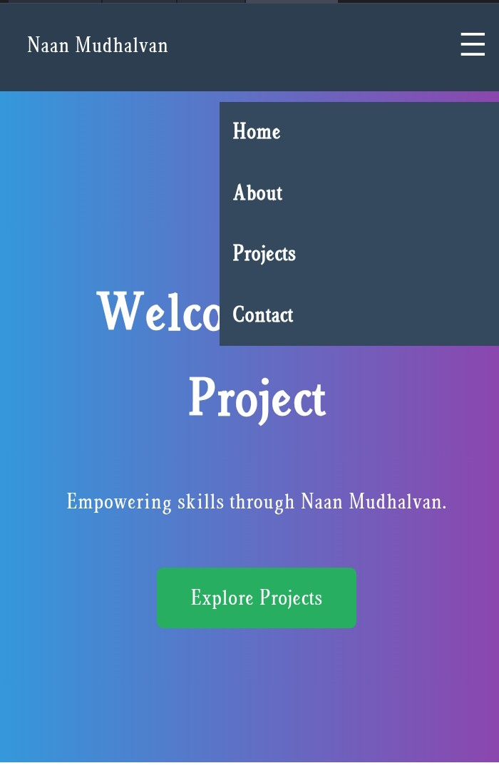
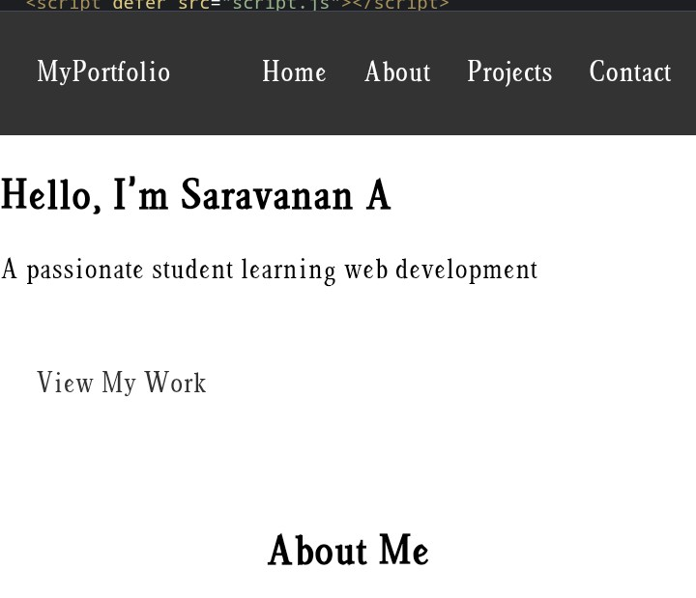
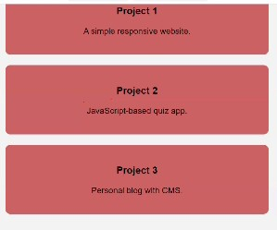
RESULTS AND SCREENSHOTS
1. The portfolio successfully showcases personal information, skills, and projects in one place.
2. Visitors can easily view work samples and navigate between different sections.
3. The use of HTML, CSS, and JavaScript results in a visually appealing layout.
4. Responsive design makes the portfolio accessible on both desktop and mobile devices.
5. The final product provides a clear snapshot of the student’s abilities and achievements.
3/21/2024 Annual Review
10
if (name && email && message) { formStatus.textContent = " Message sent successfully!"; formStatus.style.color = "green"; contactForm.reset(); } else { formStatus.textContent = " Please fill in all fields."; } formStatus.style.color = "red"; });

Slide 11
CONCLUSION
Highlights:The portfolio clearly presents key projects and personal details in a clean layout. It uses HTML, CSS, and JavaScript to create a responsive and interactive design.
Final Summary:The portfolio presents a well-structured showcase of the student’s profile, skills, and projects using HTML, CSS, and JavaScript. It delivers a responsive and visually clear platform for highlighting achievements.
Benefits to Society:This portfolio demonstrates skills that can contribute to creating user-friendly digital solutions, supporting education and career growth. It also encourages others to showcase their talents effectively, fostering a culture of learning and innovation.
11

